Slide 1
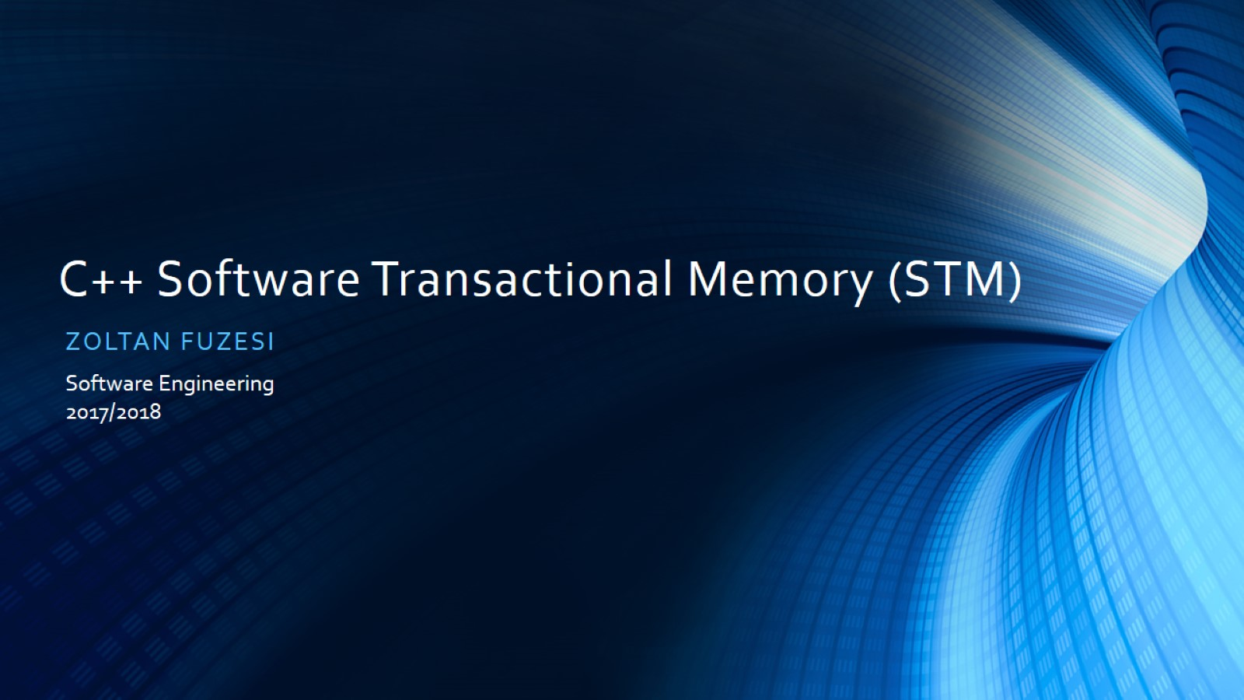
C++ Software Transactional Memory (STM)

Slide 2
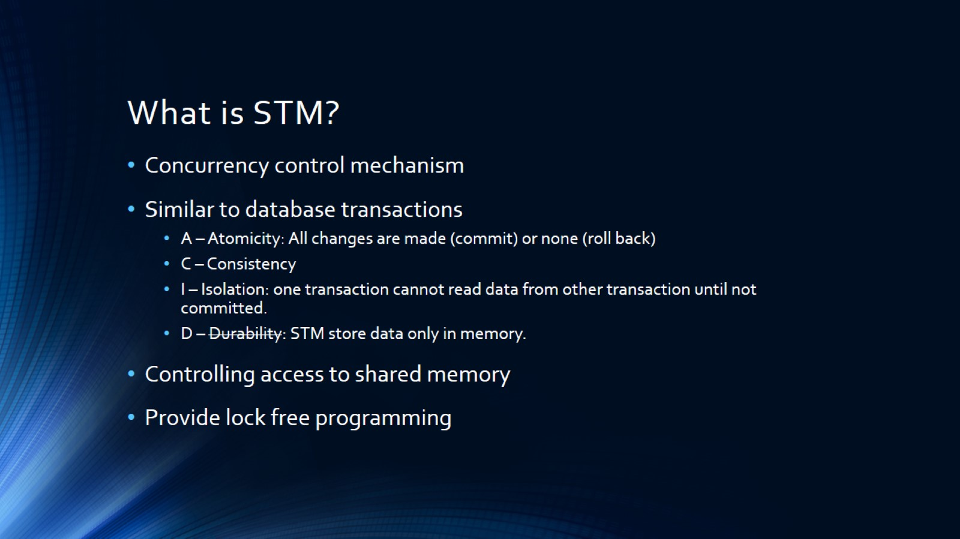
What is STM?

Slide 3
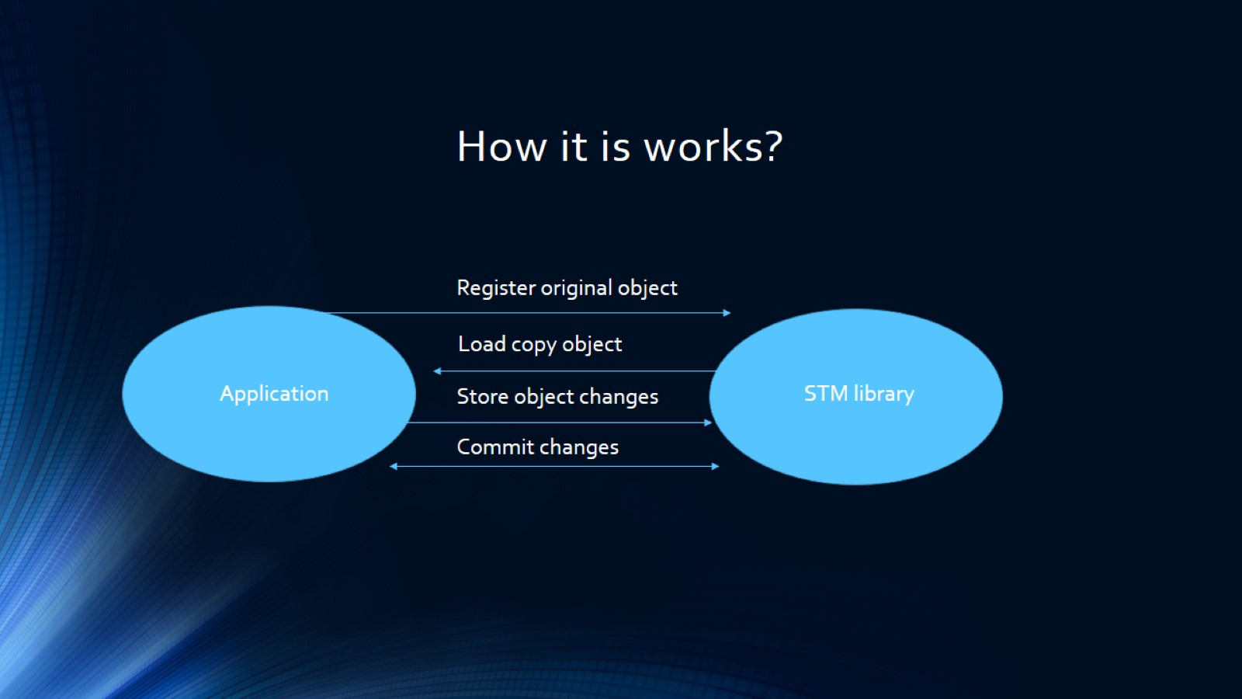
How it is works?

Slide 4
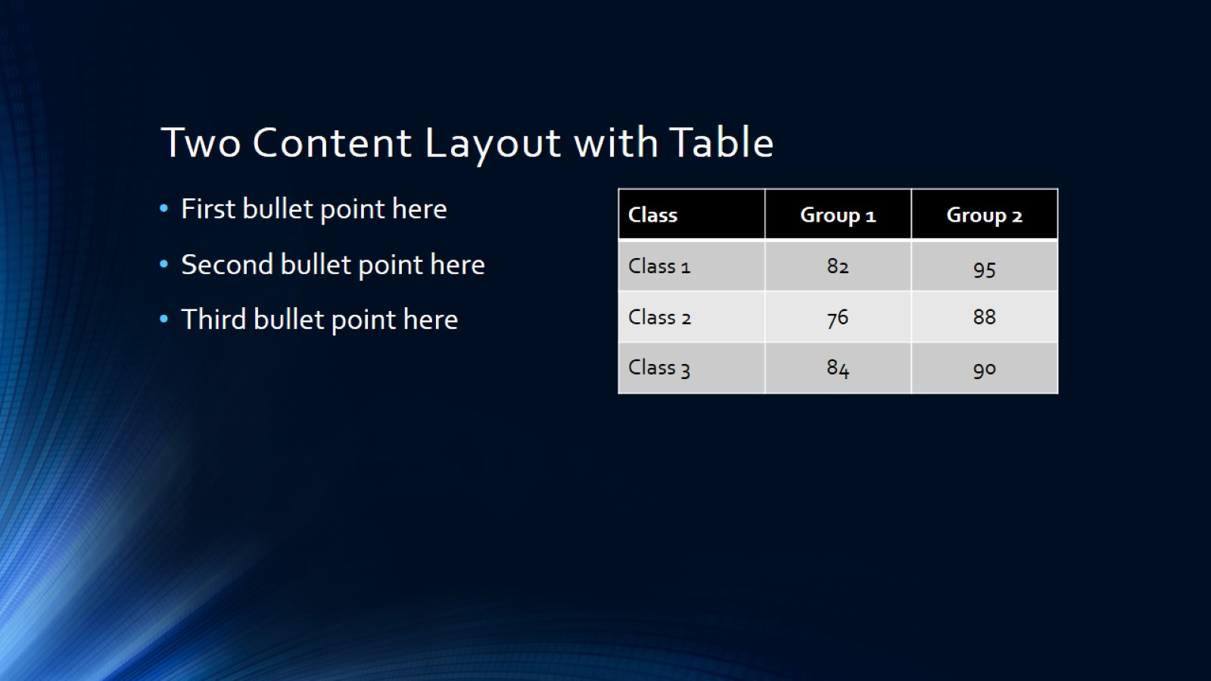
Two Content Layout with Table

Slide 5
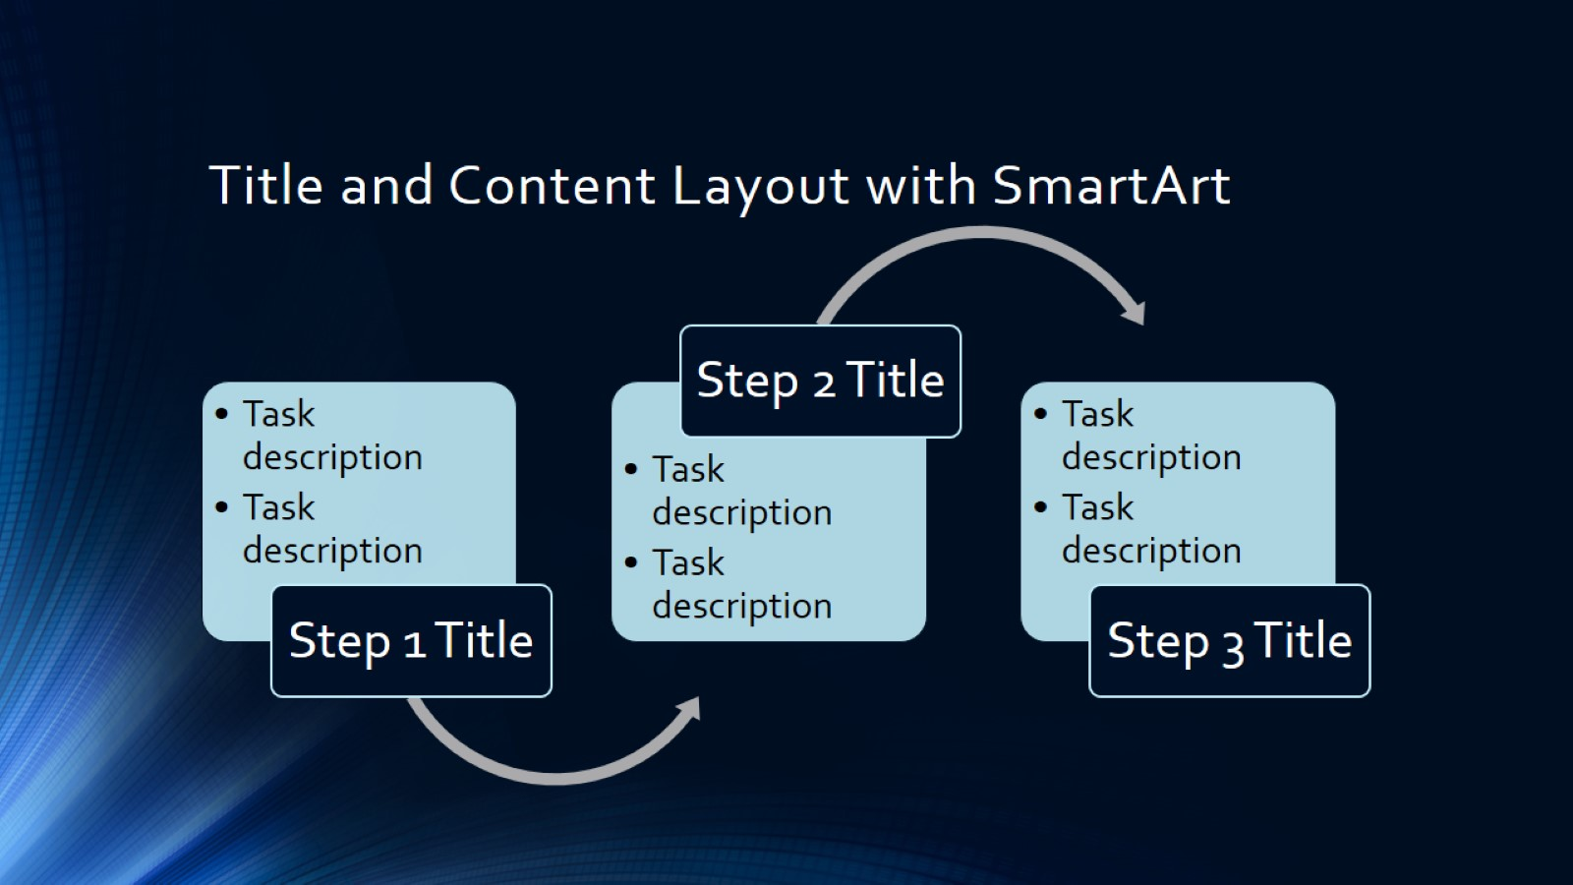
Title and Content Layout with SmartArt

Slide 6
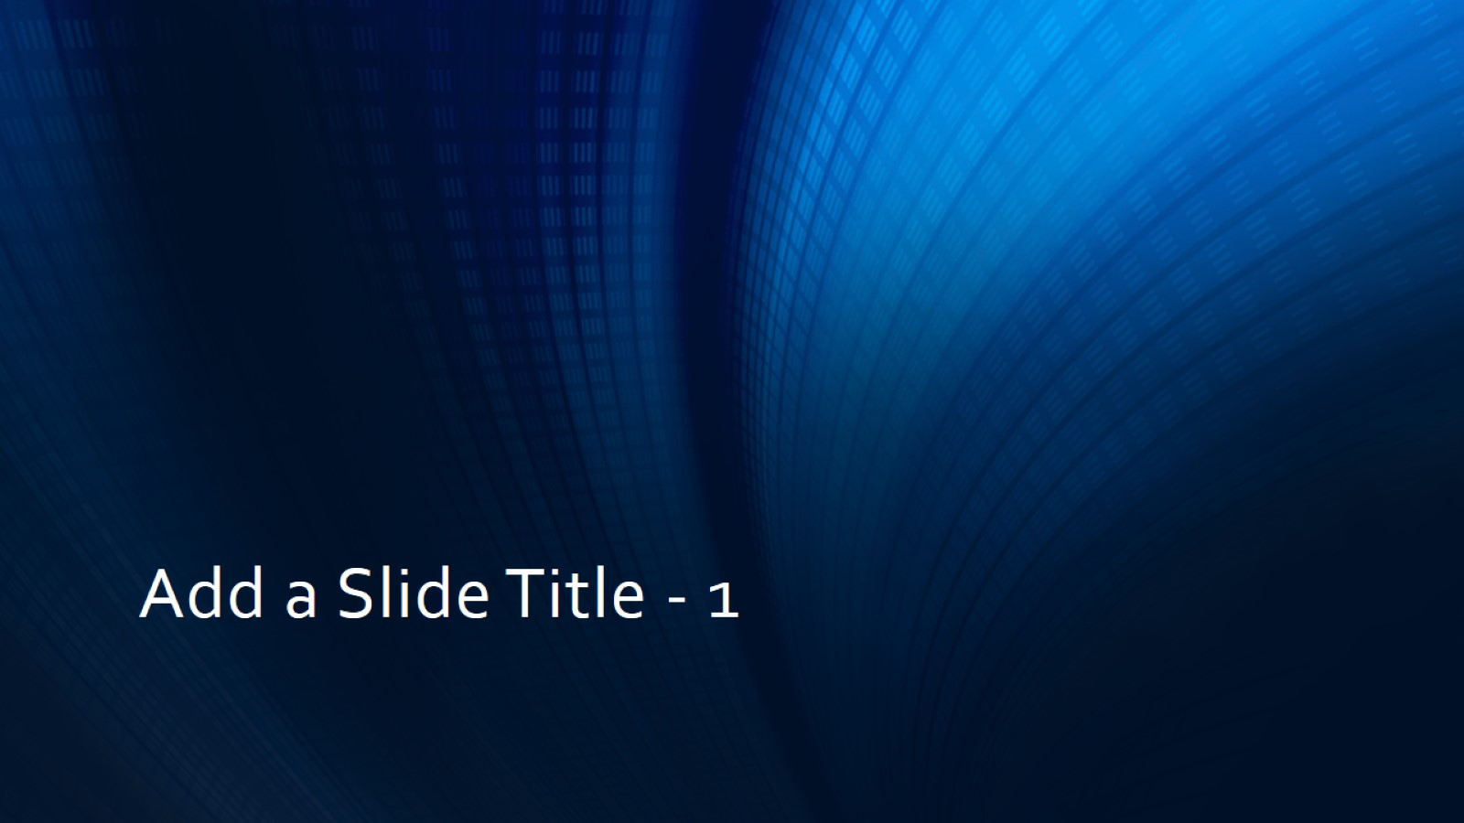
Add a Slide Title - 1

Slide 7
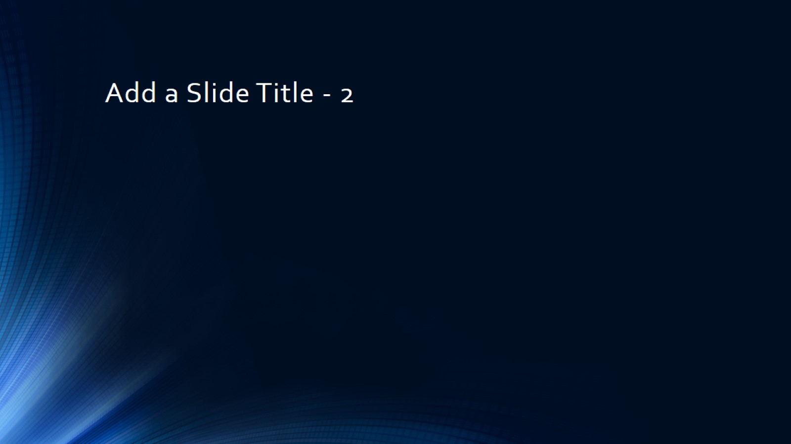
Add a Slide Title - 2

Slide 8
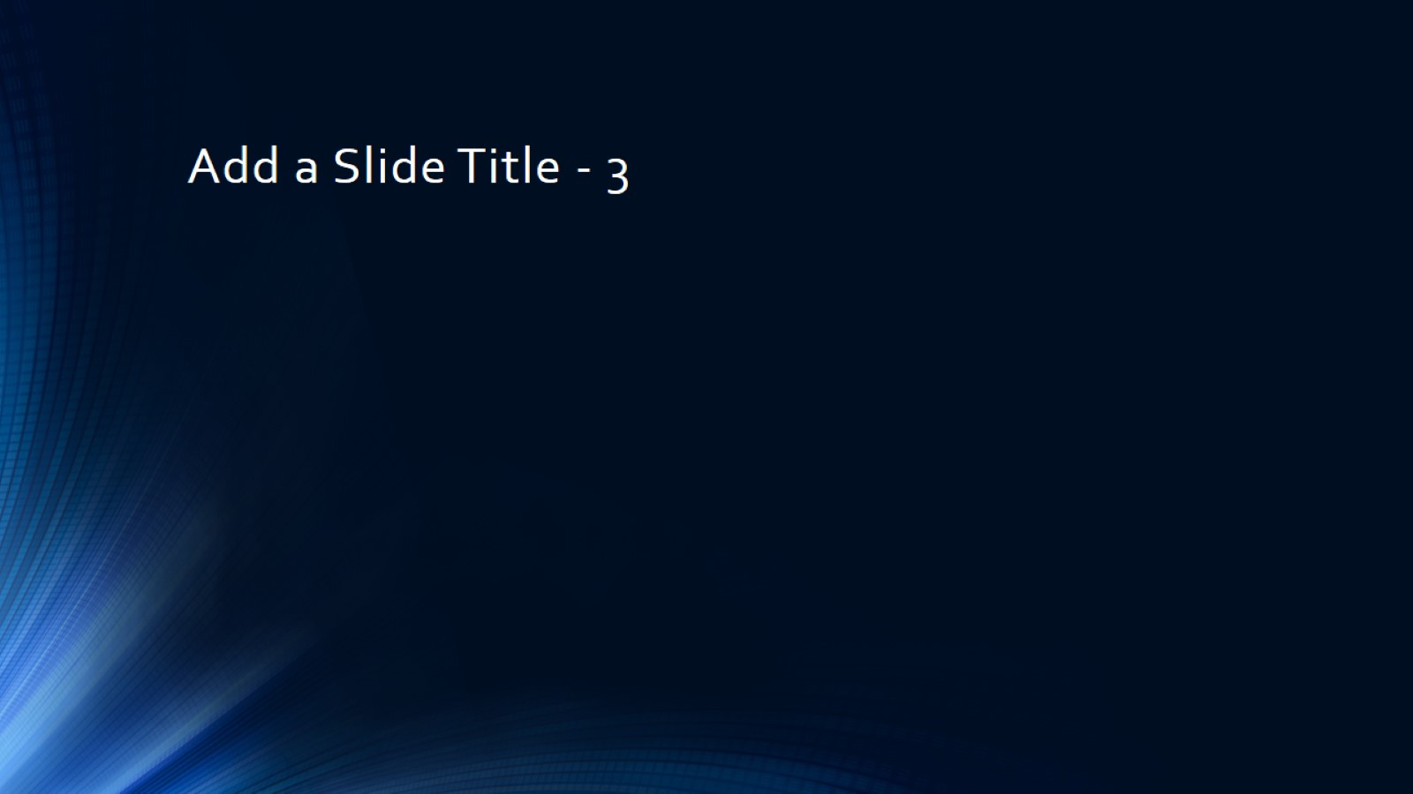
Add a Slide Title - 3

